Slide 1
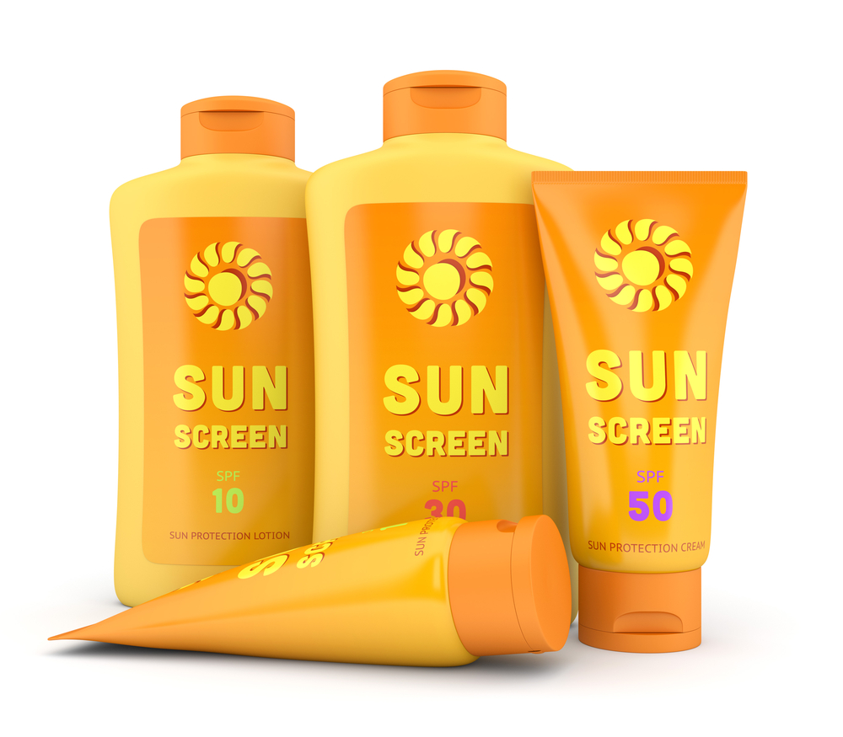
Sunscreen Body Spray and Lotion

Slide 2
Introduction
Sunscreen spays refer to prays that contain chemicals that cover the skin surface to prevent skin problems such as; skin early aging, skin irritation, and sunburns.
Hot climate conditions in America are usually not skin-friendly therefore the product helps to cover the skin and prevent the mentioned effects.

Slide 3
Place and location
The product is sold to the American people mostly since they are the most affected by their hot climatic conditions.
The products are sold in most of the shops and cosmetic outlets in America. Therefore the products seems to be available for almost everyone living around America.

Slide 4
Place and location
Using the official company outlets and wholesale shops. These outlets sell the products at a cheaper price and therefore more customers will buy from the outlets.
The outlets may also sell the product in wholesale where retailers may chose to buy the products from in wholesale and resale them in different locations.

Slide 5
Price and Distribution strategy
When it comes to costs of the products, they are usually budget friendly. From as low as five dollars, one can buy themselves a sunscreen product.
However the prices are likely to change within time and as the product upgrade. Incase the manufacturers of the products decide to add and ingredient, then it is most likely that the prices might be high a little bit.
(FrogDog, 2016)

Slide 6
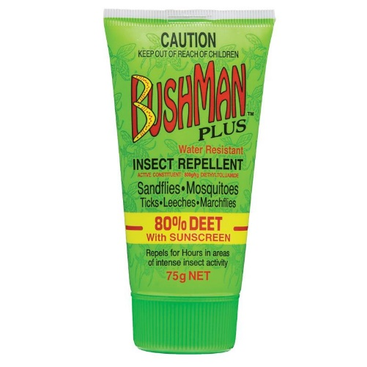
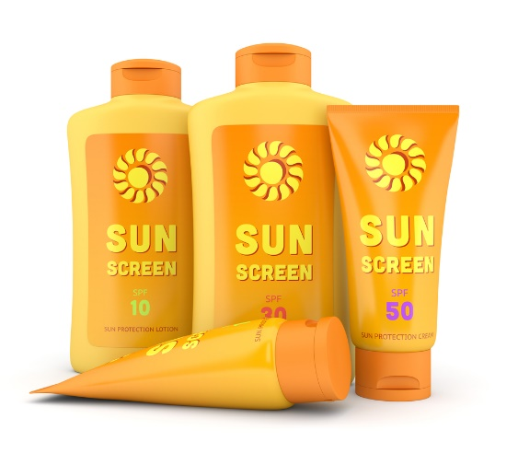
Price and Distribution strategy
Also, product prices depend on the quality of the product. For example, there are sunscreen products that not only do they protect someone from sunburns but also prevent one from insect bites.
These products cost more than the normal sunburn product. Therefore, this means that low-cost products only protect one's skin from the sun.
(Sommerfield, 2015)

Slide 7
Price and Distribution strategy
When placing an order from the company’s sellers, one buys the product at a cheaper price. However, some of the companies only sell the products at wholesale prices. Only if, the customer buys the package in bulk.
However, cheap is expensive. For example, if one only required a single product at ten dollars, then the company will only sell to them if they purchase a box of 30pcs at 10 each.

Slide 8
Budget schedule and monitoring
on budget monitoring and schedule, the distribution and collecting of funds have to be recorded. This action makes it possible to account for every product sale and the funds.
By recording the distribution and funds process, the company will be able to determine any loss or profits of the product and therefore it becomes easier to manage the company.
Oakland, 2017

Slide 9
Budget schedule and monitoring
Monitoring of the company sales helps to notice where there is a problem in the company. This way they fix the problem before it gets worse.
Also, in the case of selling different sizes and flavors, the company can know which size and flavor are mostly bought and therefore will increase the production of the product and reduce the other for more profits.
Oakland, 2017

Slide 10
Budget schedule and monitoring,
The company will also be able to know the outlets that sell such products and those that sell very little. This way they may decide to shut down the outlet and reopen them in a different place where the product is mostly bought.

Slide 11
Target Market
The product can be used generally by everyone irrespective of their age or gender, therefore, all public means of advertisements can be used. For example, using posters and billboard and also through television adverts.
This action help to attract the customers. the adverts should consist of the name of the product, price etc.
(Adams, 2017)

Slide 12
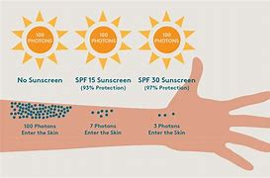
Marketing Mix
Advertising is the commonly used strategy of selling their products. Through advertisement, the companies can adverse their products. Advertising involves telling people about the product, for example, mentioning why someone should choose their products and also the services they offer.
(Australian Promotional Products, 2021)

Slide 13

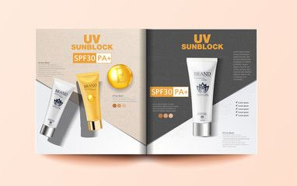
Marketing and promotion
Another advertising method is through, use of leaflets or radio. Also, as mentioned before, it depends with customers. leaflets cannot be used to advertise the sunscreen products to the old.
Also, one cannot advertise their sunscreen products to youth and teens through the radio. Therefore knowing the audience provides the good way of promoting the products.
(Melanie, 2017)

Slide 14
Appendix
The presentation slides have mentioned discussed the sunscreen product and why one should purchase the product. I have also given several reasons for the difference in the product price.
This presentation has also covered several methods of promoting the product which includes an advertisement. In which the methods are different to different groups of people.

Slide 15
References
Adams, R. (2017). 10 marketing strategies to fuel your business growth. Entrepreneur. https://www.entrepreneur.com/article/299335
Australian Promotionl Products. (n.d.). Expand your marketing with promotional sunscreen. Promotional Products – Gifts and Giveaways: Promotion Products Australia. https://www.promotionproducts.com.au/promotional-articles/Expand-Your-Marketing-with-Promotional-Sunscreen/
Dean, B. (2020). Promotion strategy: How to promote your business [2020]. Evinex Digital Marketing Agency. https://www.evinex.com/promotion-strategy/#promotion-strategy-fundamentals
FrogDog. (2016). When and how to adjust the price of your product or service. FrogDog Marketing. https://www.frog-dog.com/magazine/adjust-price-product-service
Melanie. (2020). Discount pricing strategy explained. Unleashed Software. https://www.unleashedsoftware.com/blog/discount-pricing-strategy-explained
Sommerfield, J. (2014). Does a higher price always mean higher quality? MoneyNing. https://moneyning.com/shopping-smart/does-a-higher-price-always-mean-higher-quality/
Oakland. (2017). Budget monitoring. Oakland University. https://oakland.edu/budget/budget-monitoring/#:~:text=Budget%20monitoring%20process,involved%20in%20resolving%20outstanding%20issues

